Slide 1







EXECUTIVE DECK
Student Participation Analysis
& Predictive Insights
Excelerate AI Powered Data Analysis Internship

Slide 2


Project Overview
From learner data to actionable program insights
STAGE 01
ANALYZE
Historical Participation
STAGE 02
DISCOVER
Participation Drivers
STAGE 03
PREDICT
Machine Learning
STAGE 04
RECOMMEND
Strategic Actions
STAGE 05
MEASURE
Program Impact
PROJECT ULTIMATE DELIVERABLE FRAMEWORK
DATA → INSIGHTS → DECISIONS → IMPACT

Slide 3
Dataset Overview
8,558 participation records across 16 features
LEARNER
• Demographics
• Academic Profile
• Geography
OPPORTUNITY
• Category
• Duration
• Opportunity Details
REGISTRATION
• Signup Date
• Application Date
• Timing
OUTCOME
• Participation Status
8,558
16
70
Participation Records
Features
Countries Represented
Total observations of learner applications and registrations.
Data dimensions capturing learner, opportunity, and status traits.
Global reach identified through core geographical analysis.
PROJECT ULTIMATE DELIVERABLE FRAMEWORK
A single dataset connects learner characteristics, opportunity attributes, registration behaviour, and participation outcomes.

Slide 4

Historical Participation Insights
Participation is concentrated by opportunity type and geography, while registration activity shows clear temporal patterns.
1. Participation by Opportunity
2. Geographic Participation
3. Participation Growth
Internship
63.34%
United States
46.46%
Jan: >2,000
Feb Peak
Course
23.80%
India
33.14%
Aug: ~700
Event
6.37%
Nigeria
8.88%
Competition
4.97%
Ghana
3.21%
Mar Drop
Engagement
1.52%
Pakistan
2.56%
Oct '22
Aug '23
Feb '24
KEY TAKEAWAY: Internships account for 63.34% of all participation, more than 2.6× the share of Courses.
88.48% FROM US, INDIA & NIGERIA
A highly concentrated global footprint spanning over 70 countries represented platform-wide.
DRIVEN BY INTERNSHIPS: Temporal activity spikes coincide with major internship recruitment periods..
87.14%
Internship + Course Share
Dominating overall learner engagement and program preference.
88.48%
Top 3 Countries
Primary concentration across United States, India, and Nigeria.
Aug 2023 → Jan–Feb 2024
Major Participation Peaks
Accelerated growth intervals tied directly to key internship recruitment windows.

Slide 5

Exploratory Data Analysis
Learner participation is concentrated in internships, varies by application status, and shows clear temporal patterns.
1. Opportunity Distribution
2. Participation Status
3. Monthly Participation Trend
Internship
5.4k | 63.3%
Internship
Jan-Feb: >2,000
Course
2.0k | 23.8%
65.8% Rej | 21.5% Allocated
Event
545 | 6.4%
Course
54.7% Team Allocated
Competition
425 | 5.0%
Competition
Engagement
130 | 1.5%
84.2% Team Allocated
Event
Aug '23: ~700
87.14% of participation comes from Internships and Courses
94.1% Team Allocated
Mar '24 Drop
Engagement
Oct '22
Aug '23
Feb '24
Mar '24
96.9% Team Allocated
Dominant Categories: Internships and Courses represent the vast majority of learner interest, leaving community engagement at marginal levels.
Rejected
Allocated (Intern)
Allocated (Other)
Participation growth was primarily driven by structured internship recruitment cycles.
Outcome Contrast: Other opportunity categories show substantially higher Team Allocated rates than Internships.
OPPORTUNITY MIX
Internships dominate general engagement, reflecting career-centric learner priorities over courses or community events.
APPLICATION OUTCOMES
High Internship selectivity leads to a 65.8% rejection rate, presenting a stark contrast to other highly accessible formats.
TIME PATTERN
Spikes align with semesters, peaking dramatically in Jan-Feb before dropping, indicating tight ties to academic cycles.

Slide 6
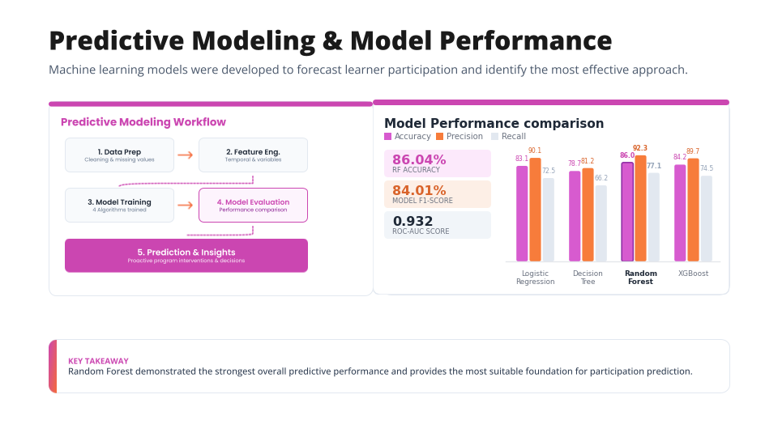

Slide 7
Key Drivers of Learner Participation
Feature importance analysis identified the variables with the greatest influence on learner participation.
Feature Importance Analysis (Random Forest)
Key Business Insight
Opportunity Category
0.433
Category
0.433
Duration
0.240
Opportunity Duration
0.240
Signup Month
0.058
Current/Intended Major
0.056
0.673
Combined Influence
of Category & Duration
Institution Name
0.054
Age
0.052
Signup Hour
0.044
Program design and duration are the strongest predictive drivers of participation.
The data clearly signals that factors controlled during program formulation have far more leverage over learner engagement than demographic targeting or user profiles.
Signup DayOfWeek
0.027
Country
0.026
Gender
0.010
Strategic Implication: Focus optimization on opportunity design, duration and timing before demographic targeting.

Slide 8



Model Interpretation & Prediction Insights
Understanding why the model predicts participation and how accurately it distinguishes participating learners.
Feature Importance
RF Confusion Matrix
ROC Classification Performance
Opportunity Category
0.433
Predicted No
Predicted Yes
Opportunity Duration
0.240
845
52
TPR (Sens.)
Signup Month
0.058
Actual No
True Neg (TN)
False Pos (FP)
Current/Intended Major
0.056
0.932
Institution Name
0.054
187
628
ROC-AUC SCORE
Age
0.052
Actual Yes
False Neg (FN)
True Pos (TP)
Excellent Discrimin.
Signup Hour
0.044
Signup DayOfWeek
0.027
0.0
0.0 (FPR)
1.0
Country
0.026
Classification Power:
1,473 of 1,712 observations were correctly classified, indicating high model precision and operational predictability.
Gender
0.010
Discriminative Index:
The score of 0.932 proves strong performance in isolating high-intent learners from passive profiles.
Key Insight: Opportunity Category and Duration account for the strongest predictive influence. Together they form the core drivers derived from Random Forest feature analysis.
Strategic Insight: The model is strongest when identifying opportunity-related drivers, while its high ROC-AUC demonstrates strong ability to distinguish likely participants from non-participants.

Slide 9
Strategic Recommendations
Five evidence-based actions to improve participation, opportunity access, and program effectiveness.
01
Optimize Opportunity Mix
Prioritize high-demand opportunity design based on learner demand data.
63.34%
Internship participation vs. 23.80% courses.
02
Expand Opportunity Capacity
Address significant gap between demand and available internship spaces.
65.84%
Rejected applicants with only 21.49% allocated.
03
Target High-Potential Periods
Align key campaign outreach with proven historical peak months.
Aug / Jan / Feb
Historically proven participation peak times.
04
Target New Markets
Broaden geographic reach to diversify current user distribution.
88.48%
Concentrated in US, India, and Nigeria.
05
Use Predictive Analytics
Forecast user behavior to enable proactive planning cycles.
86.04% 0.932
Model accuracy and operational ROC-AUC score.
Expected Business Impact Flow
Better Opportunity Design
Higher Access
Targeted Engagement
Improved Participation
Data-Driven Program Planning

Slide 10
Success Measurement Framework
Track participation, program outcomes, and predictive performance to continuously improve future cohorts.
01
Participation
02
Program Outcomes
03
Predictive Performance
Participation Rate
Learner participation across opportunities
Completion Rate
Learners progressing through opportunities
Prediction Accuracy
Monitor model accuracy over time
Opportunity Fill Rate
Demand versus available placements
Repeat Participation
Learners returning for additional opportunities
ROC-AUC
Track classification quality
Geographic Diversity
Participation across countries and regions
Application Outcomes
Allocation, rejection and dropout patterns
Feature Stability
Monitor driver stability across cohorts
8,558
PARTICIPATION RECORDS
70
COUNTRIES
63.34%
INTERNSHIP PARTICIPATION
65.84%
INTERNSHIP REJECTION
86.04%
RANDOM FOREST ACCURACY
0.932
ROC-AUC SCORE
CONTINUOUS IMPROVEMENT
Measure
Analyze
Act
Monitor
Refine
Measure Again
Strategic Alignment & Dynamic Insight
Success should be measured not only by participation volume, but by access, progression, diversity, and the sustained accuracy of predictive decision-making.

Slide 11
Executive Summary & Business Impact
From historical participation patterns to predictive, data-driven program decisions.
1. Understand
Historical participation patterns
2. Predict
Machine learning models
3. Act
Apply targeted interventions
4. Improve
Measure & continuously refine
63.34%
INTERNSHIPS RECORDED
86.04%
RANDOM FOREST ACCURACY
5 Priority
STRATEGIC ACTIONS
6 Core Measures
• Participation Rate
• Opportunity Fill Rate
• Geographic Diversity
• Completion Rate
• Repeat Participation
• Prediction Accuracy
88.48%
US, INDIA & NIGERIA
0.932
ROC-AUC SCORE
• Optimize Opportunity Mix
• Expand Opportunity Capacity
• Target High-Potential Periods
• Target New Markets
• Use Predictive Analytics
EXPECTED BUSINESS IMPACT FLOW
Higher Participation
Better Opportunity Access
Smarter Resource Allocation
Continuous Program Improvement
Transform historical participation data into proactive decisions that improve learner engagement and program effectiveness.

Slide 12



INSIGHTS
Thank You
DATA
Questions & Discussion
ACTION
PREDICTION
IMPACT
Student Participation Analysis & Predictive Insights
Excelerate AI Powered Data Analytics Internship

